Slide 1


Flipkart
JEDI 2.0 Team A
FlipFit

Slide 2
The Ask –
Where we started?

Slide 3















PROJECT DEVELOPMENT ROADMAP
Installation
Business & Client Package
JDBC & DAO Classes
Set up required technologies, learn basic Java, and configure Git.
Integrate SQL database and implement DAO classes.
Develop business logic and client package with demo data.
Structure
Interfaces & Data Structures
Exceptions & Java 17 Features
Design the project skeleton, identifying essential beans and structures.
Implement interfaces and Java data structures like List, Map, and Set.
Handle exceptions and utilize advanced Java 17 features.

Slide 4



Stakeholder management
Sponsors
1.SME’s
FLIPKART
Amit Balyan
01
02
Coordinators
Anushka Khanna
Chaitra Harti
Raksha Dubey
03

Slide 5

1 Weeks of Training + Project demo
LIMITLESS KNOWLEDGE
7 DAYS
168 HOURS
10,080 MINUTES
604,800
SECONDS

Slide 6



















01
Our Journey
Tech Stack
06
Agenda
02
Our Team
Development
07
Challenges & Learnings
08
03
Team Structure
04
Project Goals
Demo
09
05
Engineering
Practices
Questions
10

Slide 7





Our Journey
Explored Git, Java, and MySQL while strengthening our teamwork skills. Gained hands-on experience and deeper technical understanding.
Exploring creativity

Slide 8





1
Understanding Project
Decide Technologies JAVA
2
3
Design Thinking
Adapting to a developer
Mindset
4
5
project Demo

Slide 9

Meet Our Team

Slide 10
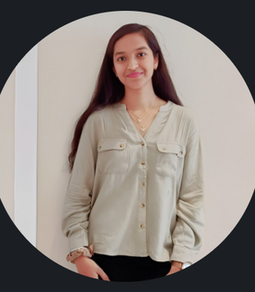

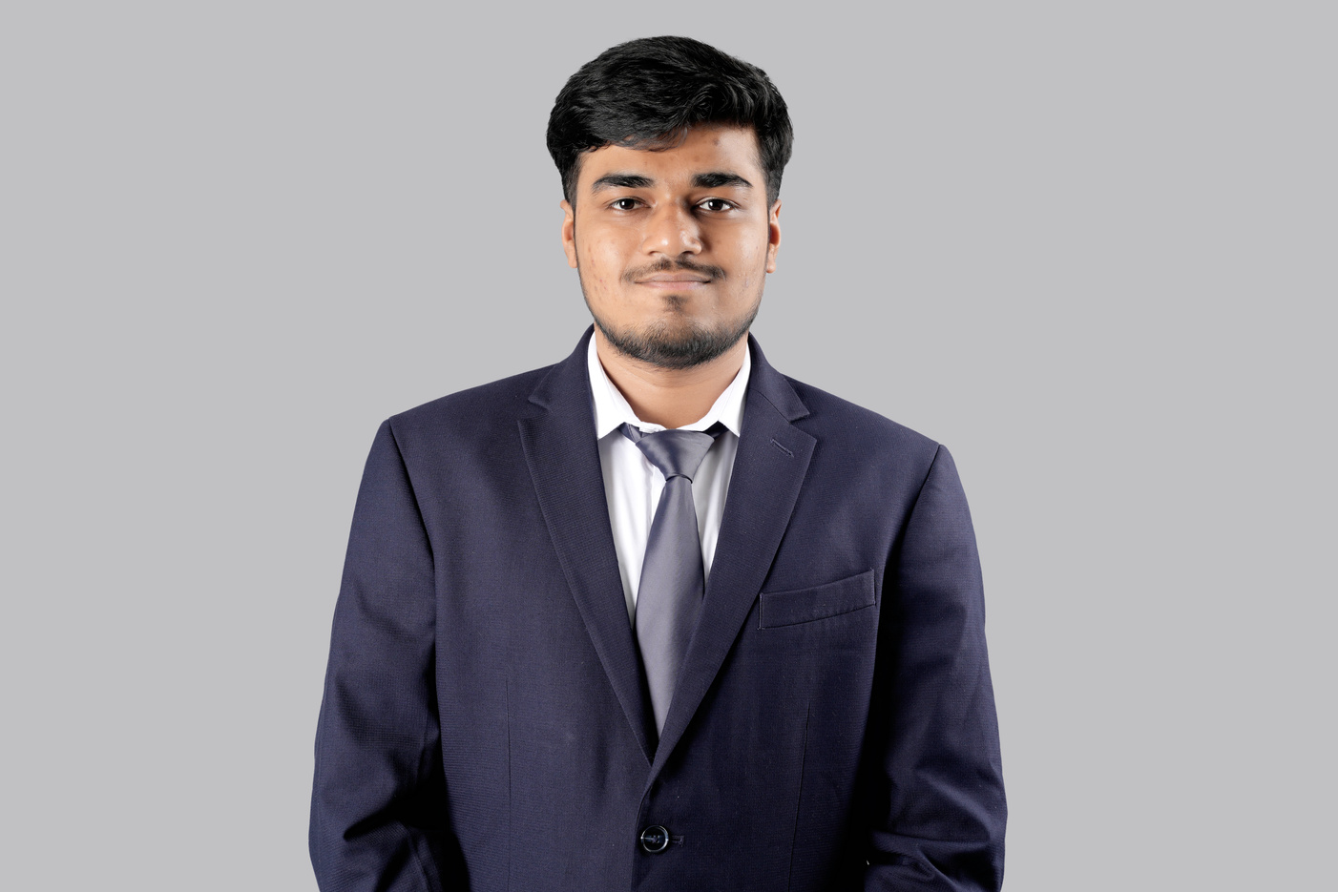
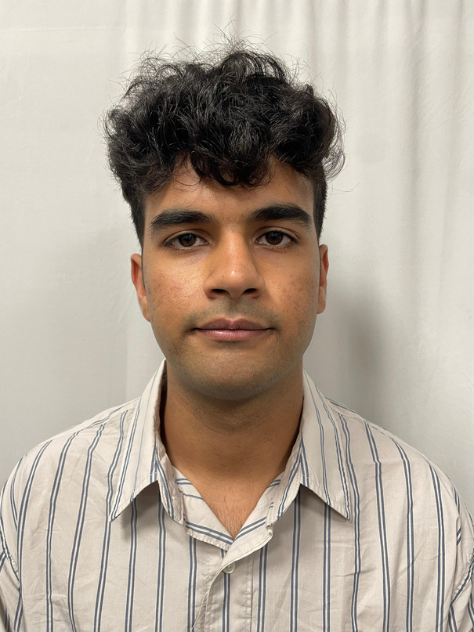
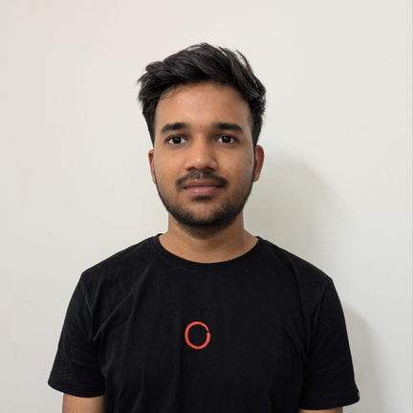
Meet The Team
Behind The Creative Process Of Building This Project
Deewanshi Bansal
Aakshat Malhotra
Ayush Raj
Commit Commander
NullPointer Exceptionalist
Merge Conflict Resolver
Naman Batheja
Mukul Kumar
Table Flipper
JDBC Junkie

Slide 11
Project Goals
We will discuss the problem statement, its impact, and our proposed solution. Our goal is to address the challenge effectively with an innovative approach.
Exploring creativity

Slide 12
Lack of a centralized platform to book gym slots in partner fitness centers.
Users face uncertainty in slot availability, leading to inconvenience.
Gyms struggle with manual slot management and tracking bookings.
Need for a seamless booking experience with real-time availability.
Problem
Statement
A user-friendly platform to discover and book workout slots at partner gyms.
Real-time slot availability based on gym capacity.
Admin dashboard for gyms to manage slots and track bookings.
Scalable backend system ensuring smooth operations and future expansion
Solution

Slide 13
Engineering Practices

Slide 14
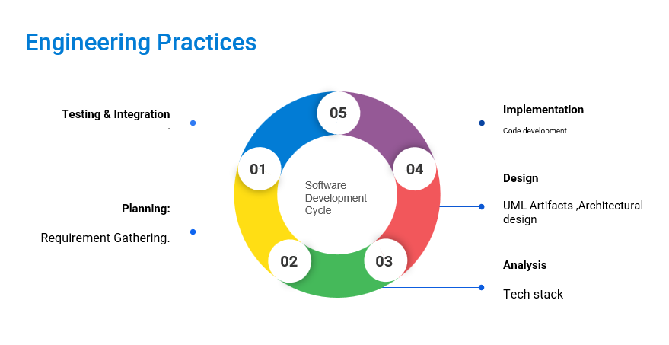

Slide 15
Artifacts

Slide 16





Tech Stack
DESIGNING UML
BACKEND
DATA
SCM
01
02
03
04

Slide 17

Development
Requirement
understanding and LLD
Development and code review
Commit and push

Slide 18
PRODUCT DEMO

Slide 19
Thank you very much!

